Slide 1
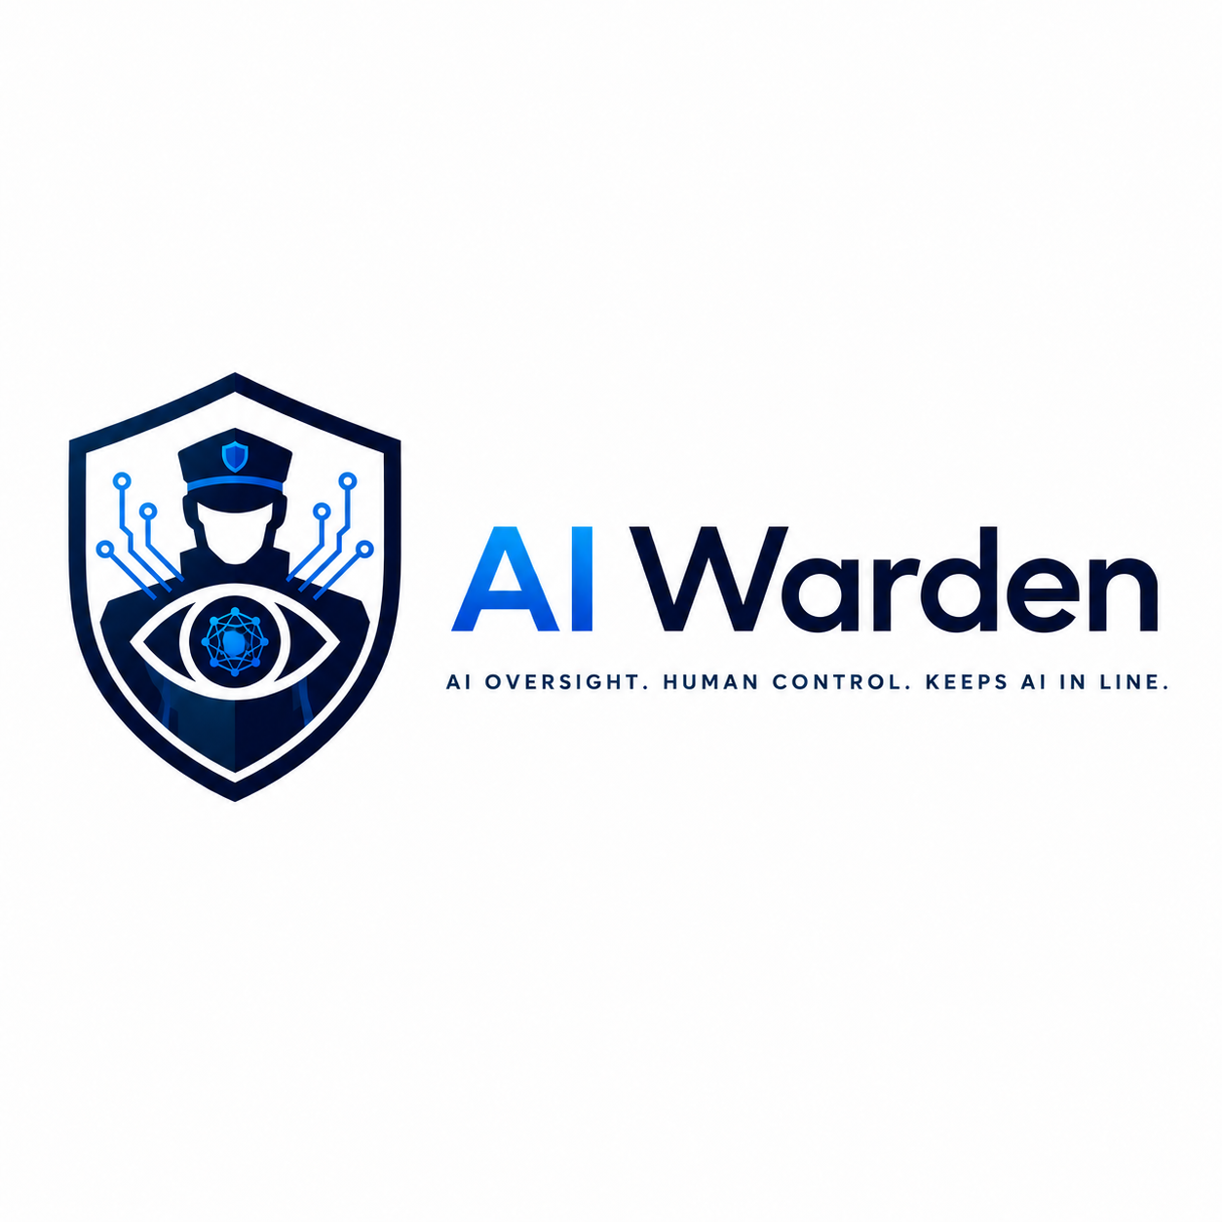
AI Powered Quality Supervisor
that keeps AI agents on track 🔧
AI agents make mistakes. They hallucinate, skip steps, and drift — silently, in production, where traditional QE cannot reach.
AI Warden is a supervisor agent that watches your AI agents work in real time, catches drift the moment it happens and brings a human quality engineer in to approve the fix.
Beyond agent supervision — the same intelligence extends across your entire SDLC. Requirements. Pipelines. Deployments. Making quality engineering a continuous platform capability, not a phase in a process.
One warden. Every layer. Always watching.
Code has unit tests. AI agents have AI Warden.

Slide 2
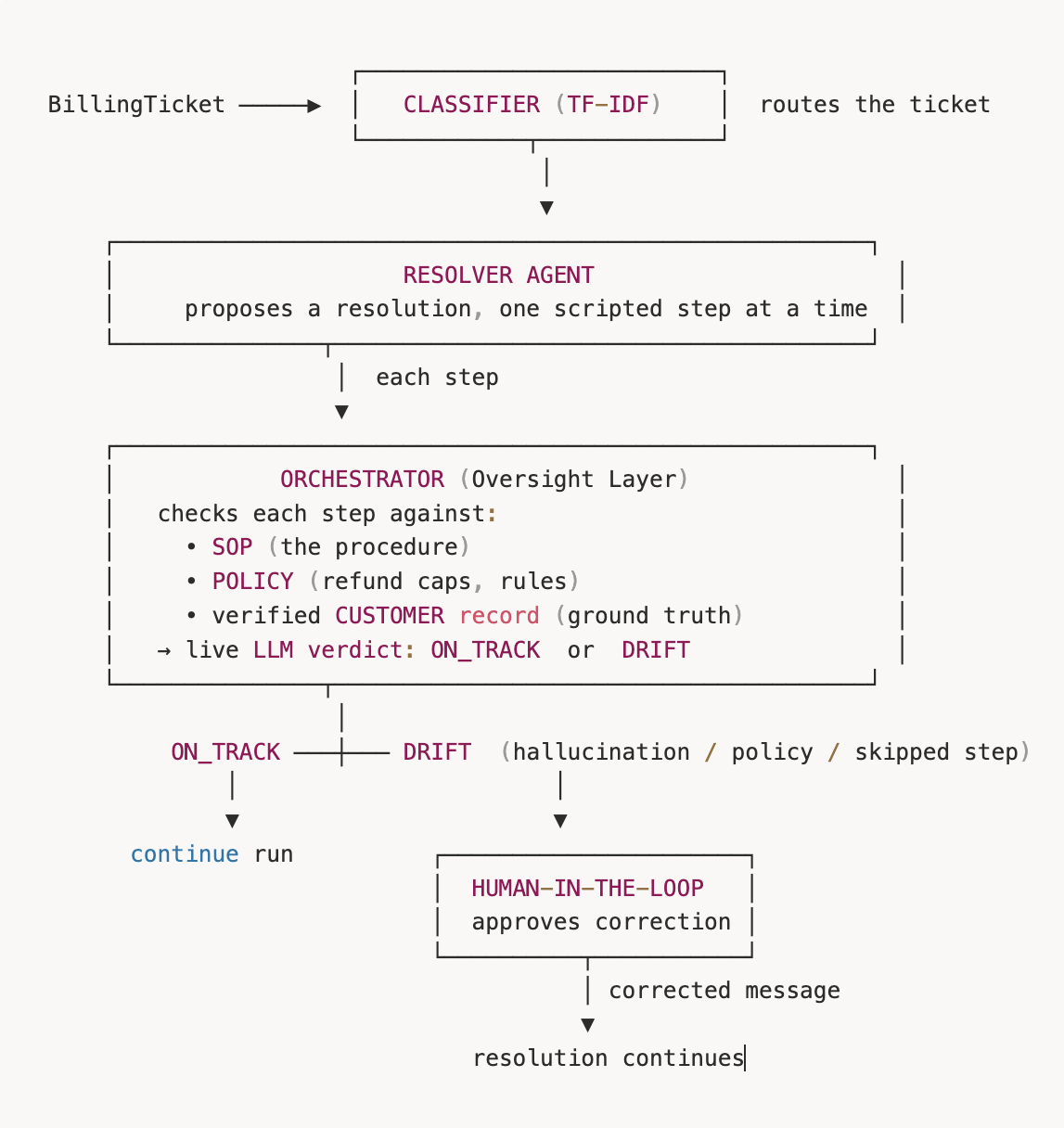
Architecture

Slide 3
Demo
https://drive.google.com/drive/folders/1OwsCZhfBlXqttmuMZYyf3DQh0Pwon62T?usp=sharing

